Slide 1



Foundation of Cloud IoT Edge ML
NPTEL Course
Dr. Rajiv Misra, Professor
Dept. of Computer Science & Engg. Indian Institute of Technology Patna
rajivm@iitp.ac.in

Slide 2

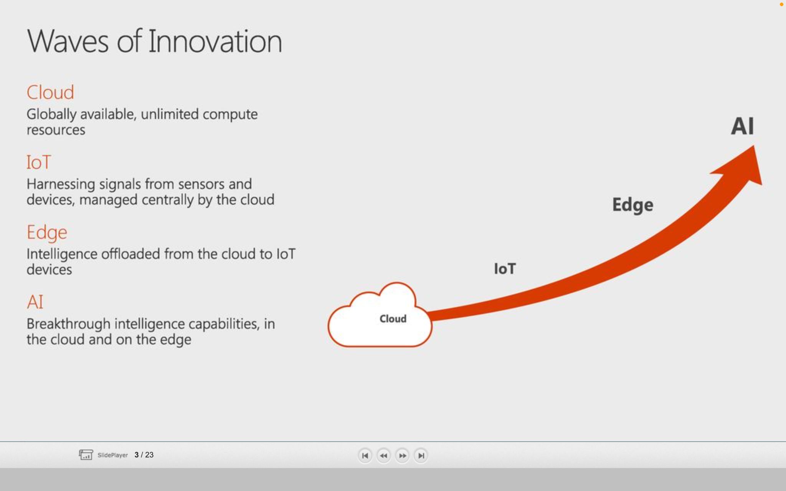
Overview: Cloud IoT Edge ML
Cloud
(the waves of innovation started with cloud)
Globally available, unlimited compute resources
IoT
(IoT-as-SaaS platform is key drivers of public cloud)
Harnessing signals from sensors and devices, managed centrally by the cloud
Edge
(IoT realize not everything needs to be in the cloud)
Intelligence offloaded from the cloud to IoT devices
ML
(rise of AI, ML models are trained in cloud are deployed at the edge to make inferencing for predictive analytics )
Breakthrough intelligence capabilities, in the cloud and on the edge
ML
Current State of Cloud
Highly centralized set of resources,
Resembles Client/Server computing
Compute is going beyond VMs as Containers becoming mainstream
Storage is complemented by CDN is replicated and cached at edge locations
Network stack is programmable SDN enabling hybrid scenarios

Slide 3
Definition: Edge Computing
Edge computing makes the cloud truly distributed
Moves core cloud services closer to the origin of data
Edge Mimics public cloud platform capabilities
Delivers storage, compute, and network services locally.
Reduces the latency by avoiding the roundtrip to the cloud
Brings in data sovereignty by keeping data where it actually belongs, savings on cloud and bandwidth usages

Slide 4
Functionality of Edge
Data Ingestion and M2M Brokers
Object Storage
Functions as a Service
Containers
Distributed Computing
NoSQL/Time-Series Database
Stream Processing
ML Models

Slide 5
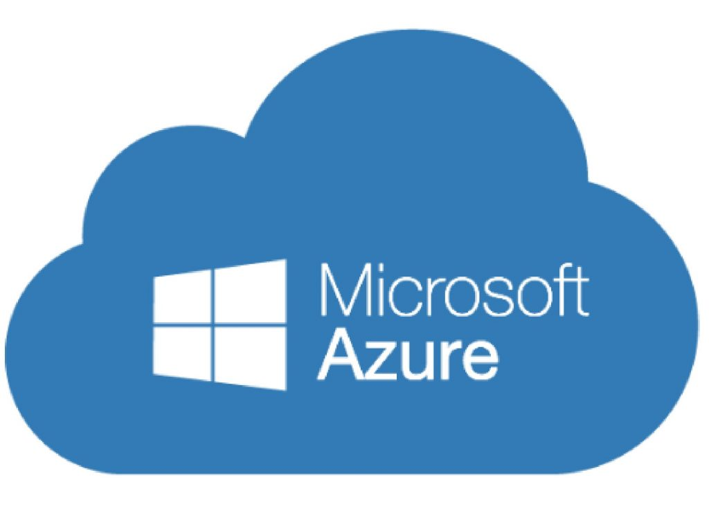
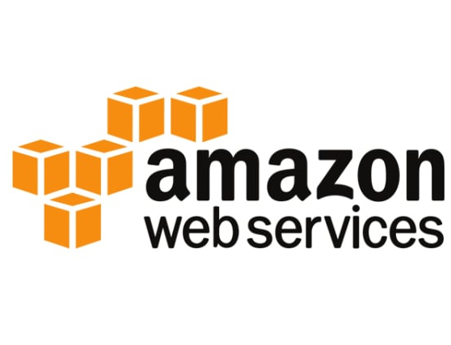
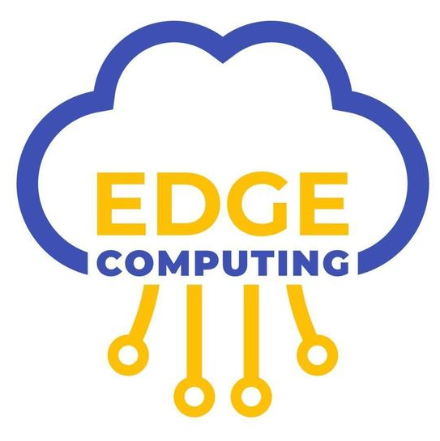
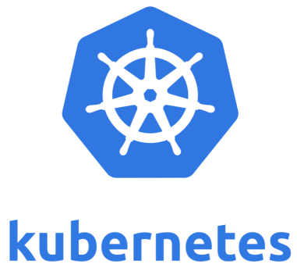
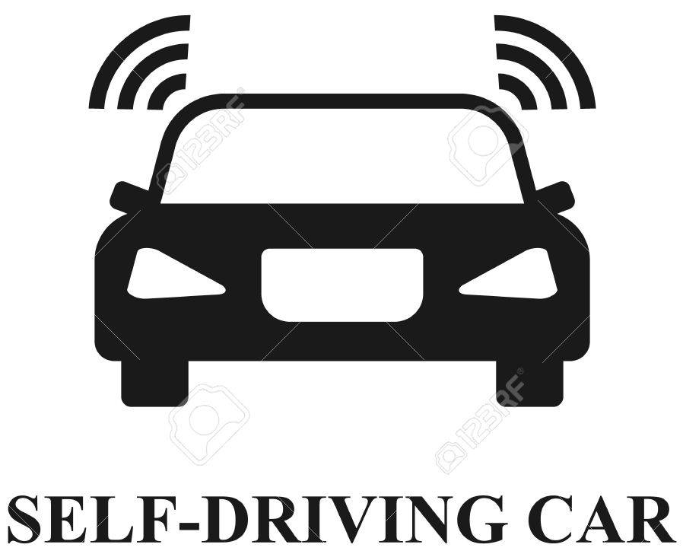
NPTEL-Course Overview
This course is a specialization in Edge Computing.
This course provides an in-depth understanding of edge computing principles with the use case of a cloud IoT edge platform.
Different edge computing fundamentals are covered, such as Docker containers, Kubernetes, MQTT, Kafka, time and clock synchronization, and key-value stores at edge. We will cover various Cloud IoT platforms that provide IoT edge services, such as Microsoft Azure IoT Hub, Amazon AWS Greengrass for IoT Edge, etc.
Recent advances of Machine Learning Inferencing at the Edge for use cases: predictive maintenance, image classifier, and self-driving cars for IoT applications such as Industry 4.0 etc.

Slide 6
Course Content
Week 1: Introduction to Cloud and its limitations to support low latency use cases.
Week 2: Edge Computing to support IoT applications such as self driving cars, etc.
Week 3: Introduction to IoT Edge platforms such as Azure IoT hub, AWS IoT platform.
Week 4: Introduction to docker container and kubernetes in edge computing.
Week 5: Concepts of distributed systems in IoT applications such as time ordering and clock synchronisation, distributed snapshot, etc.
Week 6: Design of IoT storage system like key value store.
Week 7: Introduction to MQTT and Kafka for end-to-end IoT pipeline.
Week 8: Use Cases of Machine Learning for IOT in predictive maintenance, image classifier, and self-driving cars.

Slide 7
Books
“Fog and Edge Computing: Principles and Paradigms”, Rajkumar Buyya (Editor), Satish Narayana Srirama (Editor), Wiley, 2019
“The Internet of Things: Enabling Technologies, Platforms, and Use Cases", by Pethuru Raj and Anupama C. Raman (CRC Press)
“Cloud Computing: Principles and Paradigms”, Editors: Rajkumar Buyya, James Broberg,Andrzej M. Goscinski, Wiley, 2011
“Cloud and Distributed Computing: Algorithms and Systems”, Rajiv Misra, Yashwant Patel, Wiley 2020

Slide 8

Thank You!

